Slide 1
Predicting the Mortality based on Clinical Data of patients with Cardiovascular Disease
Submitted By : Supraja Rapuru

Slide 2
Agenda
Project Motivation & Background
Methodology & Implementation
Analysis of the Results
Conclusions & Future Work
References

Slide 3
Project Motivation & Background
Heart failure occurs when the heart is not able to pump enough blood to the body. Cardiovascular diseases (CVDs) are the number 1 cause of death globally, taking an estimated 17.9 million lives each year, which accounts for 31% of all deaths worlwide.
Machine learning applied to medical records can be useful to predict the survival of a patient, highlighting patterns and even ranking the features to understand which are risk factors, possibly undetectable by doctors.

Slide 4
Heart disease dataset collected from UCI machine learning repo.
Methodology & Implementation
Data Collection, Data Preprocessing, Machine Learning Models, Implementation
Data Source: Heart disease dataset collected from UCI machine learning repo.
The table below lists out the details of all attributes in the dataset being used for the analysis
Attribute Name | Details about Attribute | Scale/Measurement | Range Of Values
Age | Age of the patient | Years | [40,..., 95]
Anaemia | Decrease of red blood cells or hemoglobin | Boolean | 0, 1
High blood pressure | If a patient has hypertension | Boolean | 0, 1
Creatinine phosphokinase-(CPK) | Level of the CPK enzyme in the blood | mcg/L | [23,..., 7861]
Diabetes | If the patient has diabetes | Boolean | 0, 1
Ejection fraction | Percentage of blood leaving the heart at each contraction | Percentage | [14,..., 80]
Sex | Woman or man | Binary | 0, 1
Platelets | Platelets in the blood | kiloplatelets/mL | [25.01,..., 850.00]
Serum creatinine | Level of creatinine in the blood | mg/dL | [0.50,..., 9.40]
Serum sodium | Level of sodium in the blood | mEq/L | [114,..., 148]
Smoking | If the patient smokes | Boolean | 0, 1
Time | Follow-up period | Days | [4,...,285]
(target) death event | If the patient died during the follow-up period | Boolean | 0, 1

Slide 5
Methodology & Implementation
Heart disease dataset collected from UCI machine learning repo.
Data Preprocessing, Machine Learning Models, Implementation
Data Preprocessing - The datasets which were collected from UCI machine learning repository and Kaggle website contain unfiltered data which must be filtered before the final data set can be used to train the
model. Also, data standardization, feature selection, handling imbalanced dataset is performed.
Machine Learning Models –Series of classification models are built to perform classification of the death event. They are Decision tree, Random forest, Linear regression, Logistic regression, Support vector machine (linear, poly, rbf), K nearest neighbors and Naive bayes
Implementation – The language used in this project is Python programming. I have run python code in anaconda navigator’s Jupyter notebook. The advantage of Jupyter notebook is that while writing code, it’s really helpful for Data visualization and plotting some graphs like histogram and heatmap of correlated matrices. Deployment of the model which gave the best performance metrics.

Slide 6
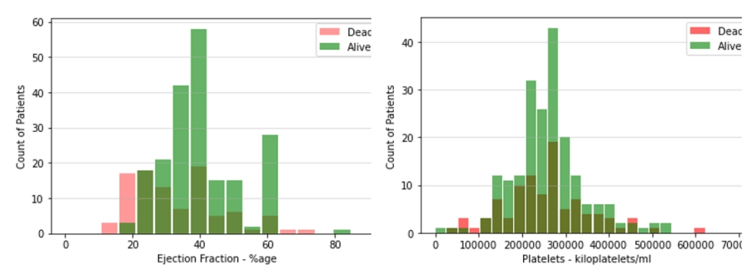
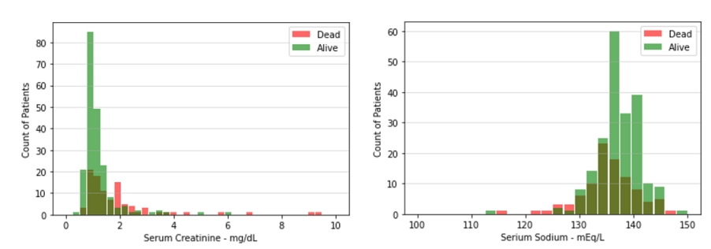
Analysis of Results
Heart disease dataset collected from UCI machine learning repo.
Histograms – Observations are
With lower Ejection fraction the risk increases
With higher serum creatinine levels risk increases
With lower serum sodium levels risk increases

Slide 7
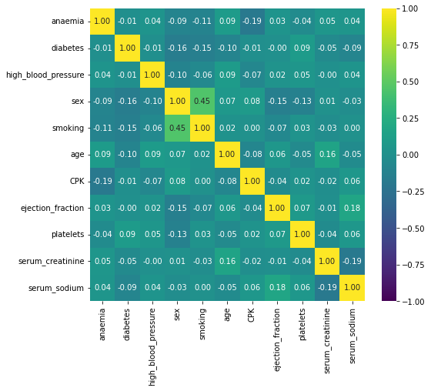
Analysis of Results
Heart disease dataset collected from UCI machine learning repo.
Correlation Matrix/Heatmap
From the heatmap we can see that in general, features are quite uncorrelated with the exception of sex and smoking that seems to be slightly positively correlated

Slide 8
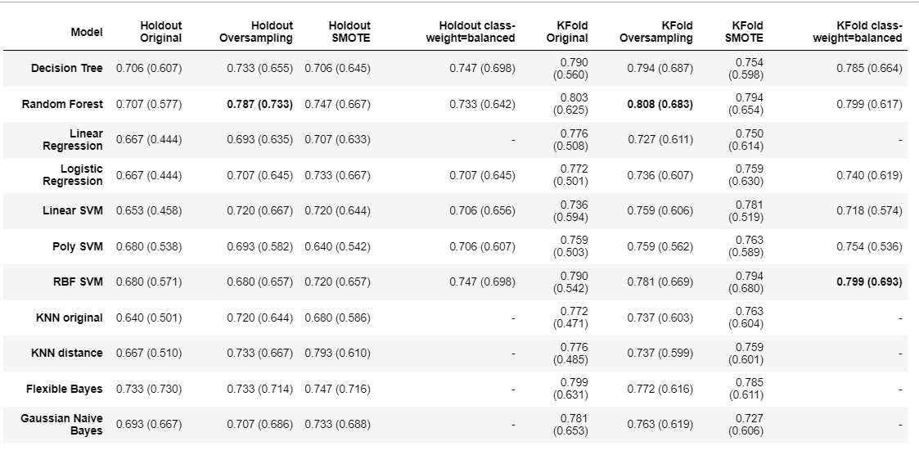
Analysis of Results
Heart disease dataset collected from UCI machine learning repo.
Used accuracy and F1 scores metrics are used for model evaluation
Both accuracy and f1 score (inside parenthesis) are showed.
Best overall model seems to be the random forest trained on the oversampled dataset, that delivers the best results in terms of accuracy and f1 score. Also RBF-SVM with class-weights=balanced provides some good results on KFold.

Slide 9
Conclusions & Future Work
In this research, I have used 11 different machine learning algorithms such Decision tree, Random forest, Linear regression, Logistic regression, Support vector machine (linear, poly, rbf), K nearest neighbors and Naive bayes for prediction of heart disease. I have used dataset from the UCI machine learning repository . Best overall model seems to be the random forest trained on the oversampled dataset, that delivers the best results in terms of accuracy and f1 score. For Performance measurement, I used accuracy and F1 scores
evaluation metrics.
Based on the results which we got in this research it indicates that applying machine learning algorithms are important to predict heart disease in an early stage. This system could assist doctors in diagnosing heart disease.
In the future, I may investigate deep learning algorithms to see the results.

Slide 10
References
https://www.healthline.com/health/creatinine-blood#results
https://www.mayoclinic.org/diseases-conditions/heart-disease/symptoms-causes/syc-20353118#:~:text=The%20term%20%22heart%20disease%22%20is,pain%20(angina)%20or%20stroke.
D. Chicco, G. Jurman. "Machine learning can predict survival of patients with heart failure from serum creatinine and ejection fraction alone", 2020
N. V. Chawla, K. W. Bowyer, L. O. Hall, W. P. Kegelmeyer. SMOTE: Synthetic Minority Over-sampling Technique, 2002
G. H. John, P. Langley. Estimating Continuous Distributions in Bayesian Classifiers, 1995

